Slide 1


Slide 2
CMU Graduate Complexity Lecture 20
Valiant’s Theorem: Permanent is #P-complete
Ryan O’Donnell
(Proof exposition from [Dell–Husfeldt–Marx–Taslaman–Wáhlen’14 & Bläser’15].)

Slide 3


Let $A∈ℤ^{n×n}$. Its permanent is:
$$\operatorname{Per}{(A)}=\sum_{σ∈S_{n}}{\prod_{i=1}^{n}{A_{iσ\left(i\right)}}}$$
Valiant’s Theorem:
Computing Permanent, even on 0-1 matrices, is #P-complete.
poly-time reduction
#3SAT
Per_{{0,1}}

Slide 4
Let $A∈ℤ^{n×n}$. Its permanent is:
$$\operatorname{Per}{(A)}=\sum_{σ∈S_{n}}{\prod_{i=1}^{n}{A_{iσ\left(i\right)}}}$$
Valiant’s Theorem:
Computing Permanent, even on 0-1 matrices, is #P-complete.
#3SAT
#3SAT^{bal}
Per_{{−1,0,1}}
Per_{{0,1,…,n}}
Per_{{0,1}}

Slide 5
Let $A∈ℤ^{n×n}$. Its permanent is:
$$\operatorname{Per}{(A)}=\sum_{σ∈S_{n}}{\prod_{i=1}^{n}{A_{iσ\left(i\right)}}}$$
(previously done:
interpolation, or
reduction mod big #)
(trivial)
(main)
(easy)
#3SAT
#3SAT^{bal}
Per_{{−1,0,1}}
Per_{{0,1,…,n}}
Per_{{0,1}}

Slide 6
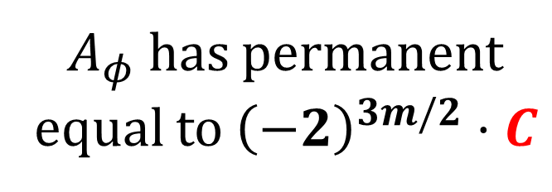
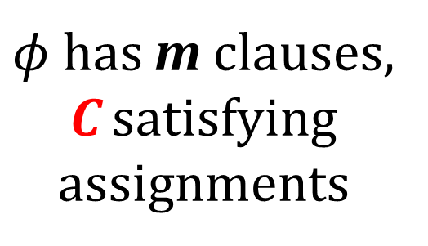
Let $A∈ℤ^{n×n}$. Its permanent is:
$$\operatorname{Per}{(A)}=\sum_{σ∈S_{n}}{\prod_{i=1}^{n}{A_{iσ\left(i\right)}}}$$
$φ$ has m clauses,
C satisfying
assignments
$A_{φ}$has permanent
equal to ${\left(−2\right)}^{3m/2}⋅C$
(main reduction)
#3SAT^{bal}
Per_{{−1,0,1}}

Slide 7

Let $A∈ℤ^{n×n}$. Its permanent is:
$$\operatorname{Per}{(A)}=\sum_{σ∈S_{n}}{\prod_{i=1}^{n}{A_{iσ\left(i\right)}}}$$
Useful reinterpretation of $\operatorname{Per}{(A)}$:
Cycle Covers

Slide 8
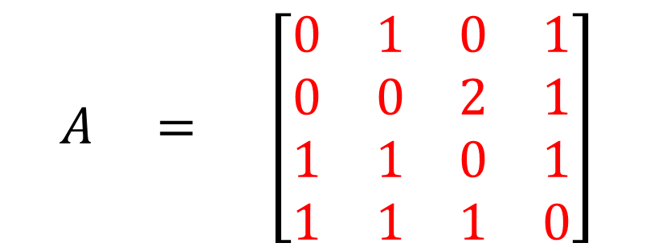

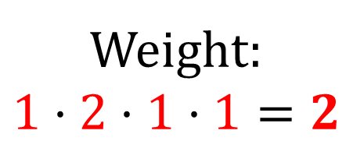

Cycle Covers
1
1
1
1
2
3
4
1
1
$$A = \left[\begin{matrix}0 & 1 & 0 & 1 \\ 0 & 0 & 2 & 1 \\ 1 & 1 & 0 & 1 \\ 1 & 1 & 1 & 0\end{matrix}\right]$$
1
2
1
4
1
1
1
3
1
2
3
4
2
$$\operatorname{Per}{(A)}=\sum_{σ∈S_{n}}{\prod_{i=1}^{n}{A_{iσ\left(i\right)}}}$$
1
2
3
4
Weight:
$$1⋅2⋅1⋅1=2$$
$$σ:$$
2
3
4
1
“Weight” = product of edge labels

Slide 9
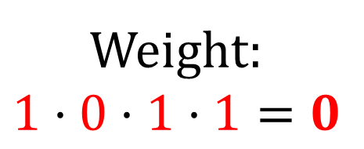
Cycle Covers
1
1
1
1
2
3
4
1
1
$$A = \left[\begin{matrix}0 & 1 & 0 & 1 \\ 0 & 0 & 2 & 1 \\ 1 & 1 & 0 & 1 \\ 1 & 1 & 1 & 0\end{matrix}\right]$$
1
2
1
4
1
1
1
3
1
2
3
4
2
$$\operatorname{Per}{(A)}=\sum_{σ∈S_{n}}{\prod_{i=1}^{n}{A_{iσ\left(i\right)}}}$$
1
2
3
4
Weight:
$$1⋅0⋅1⋅1=0$$
$$σ:$$
2
1
4
3
“Weight” = product of edge labels

Slide 10

Cycle Covers
1
1
1
1
2
3
4
1
1
$$A = \left[\begin{matrix}0 & 1 & 0 & 1 \\ 0 & 0 & 2 & 1 \\ 1 & 1 & 0 & 1 \\ 1 & 1 & 1 & 0\end{matrix}\right]$$
1
2
1
4
1
1
1
3
1
2
3
4
2
$$\operatorname{Per}{(A)}=\sum_{σ∈S_{n}}{\prod_{i=1}^{n}{A_{iσ\left(i\right)}}}$$
1
2
3
4
Weight:
$$1⋅2⋅1⋅1=2$$
$$σ:$$
4
3
2
1
“Weight” = product of edge labels

Slide 11
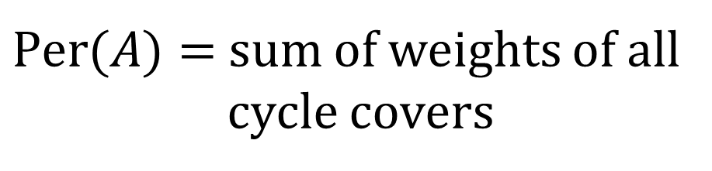
Cycle Covers
1
1
1
1
2
3
4
1
1
$$A = \left[\begin{matrix}0 & 1 & 0 & 1 \\ 0 & 0 & 2 & 1 \\ 1 & 1 & 0 & 1 \\ 1 & 1 & 1 & 0\end{matrix}\right]$$
1
2
1
4
1
1
1
3
1
2
3
4
2
$$\operatorname{Per}{(A)}=\sum_{σ∈S_{n}}{\prod_{i=1}^{n}{A_{iσ\left(i\right)}}}$$
Permutations of nonzero weight
= Cycle Covers
$\operatorname{Per}{(A)}=$ sum of weights of all
cycle covers

Slide 12
Cycle Covers
Unlabeled
edges = 1
1
1
2
3
4
$$A = \left[\begin{matrix}0 & 1 & 0 & 1 \\ 0 & 0 & 2 & 1 \\ 1 & 1 & 0 & 1 \\ 1 & 1 & 1 & 0\end{matrix}\right]$$
1
2
4
3
2
3
4
2
$$\operatorname{Per}{(A)}=\sum_{σ∈S_{n}}{\prod_{i=1}^{n}{A_{iσ\left(i\right)}}}$$
Permutations of nonzero weight
= Cycle Covers
$\operatorname{Per}{(A)}=$ sum of weights of all
cycle covers

Slide 13
Tricks with Cycle Covers
1
Trick 1: Replace weights > 1 by
parallel edges.
4
(Wait: are parallel edges “allowed”?)
2
3
2

Slide 14
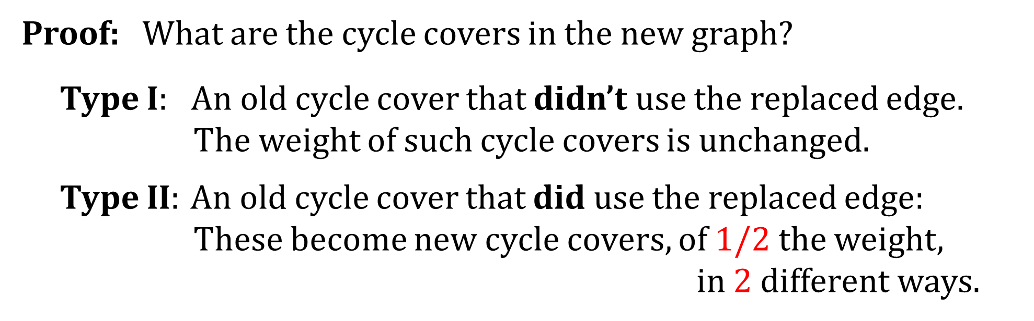
Tricks with Cycle Covers
1
Trick 1: Replace weights > 1 by
parallel edges.
4
Claim: Total cycle cover weight unchanged.
2
3
Proof: What are the cycle covers in the new graph?
Type I: An old cycle cover that didn’t use the replaced edge.
The weight of such cycle covers is unchanged.
Type II: An old cycle cover that did use the replaced edge:
These become new cycle covers, of $1/2$ the weight,
in 2 different ways.
2

Slide 15
Tricks with Cycle Covers
1
Trick 1: Replace weights > 1 by
parallel edges.
4
Are parallel edges “allowed”?
2
3
Well, no.
But…

Slide 16
Tricks with Cycle Covers
1
Trick 2: Can always subdivide any edge,
sticking in a self-loop.
4
Claim: Total cycle cover weight unchanged.
2
3
5
Proof: What are the cycle covers in the new graph?
Type I: An old cycle cover that didn’t use the subdivided edge:
→ new same-weight cycle cover by adding the self-loop
Type II: An old cycle cover that did use the subdivided edge:
→ new same-weight cycle cover that takes the length-2
path, avoiding the self-loop.

Slide 17
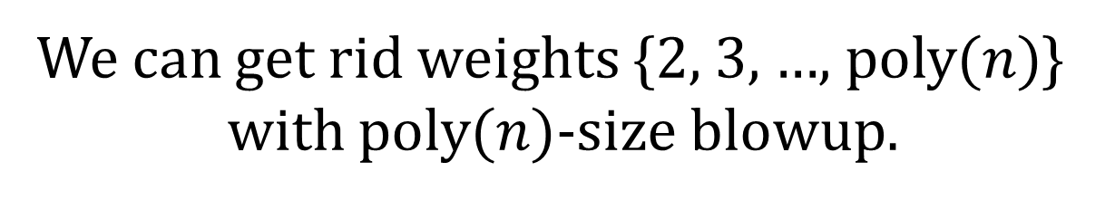
Tricks with Cycle Covers
1
We henceforth allow parallel edges.
4
We can get rid weights {2, 3, …, $\operatorname{poly}{(n)}$}
with $\operatorname{poly}{(n)}$-size blowup.
2
3
5
(trivial)
(main)
✔
(easy)
#3SAT
#3SAT^{bal}
Per_{{−1,0,1}}
Per_{{0,1,…,n}}
Per_{{0,1}}

Slide 18
Tricks with Cycle Covers
1
We henceforth allow parallel edges.
4
We can get rid weights {2, 3, …, $\operatorname{poly}{(n)}$}
with $\operatorname{poly}{(n)}$-size blowup.
2
3
(trivial)
(main)
✔
✔
#3SAT
#3SAT^{bal}
Per_{{−1,0,1}}
Per_{{0,1,…,n}}
Per_{{0,1}}

Slide 19
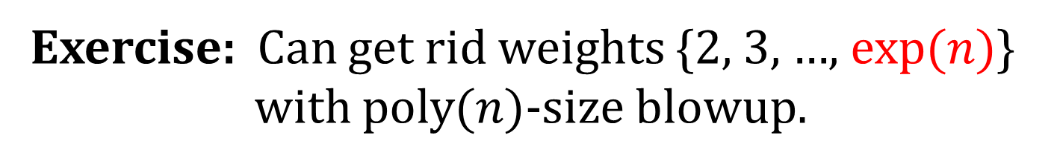
Tricks with Cycle Covers
1
We henceforth allow parallel edges.
4
We can get rid weights {2, 3, …, $\operatorname{poly}{(n)}$}
with $\operatorname{poly}{(n)}$-size blowup.
2
3
Exercise: Can get rid weights {2, 3, …, $\exp{(n)}$}
with $\operatorname{poly}{(n)}$-size blowup.
256
Hint:
u
v
2
2
2
2
2
2
2
2
=
u
v

Slide 20
Tricks with Cycle Covers
1
We henceforth allow parallel edges.
4
We can get rid weights {2, 3, …, $\operatorname{poly}{(n)}$}
with $\operatorname{poly}{(n)}$-size blowup.
2
3
Exercise: Can get rid weights {2, 3, …, $\exp{(n)}$}
with $\operatorname{poly}{(n)}$-size blowup.
256
256+32
Hint:
=
u
v
u
v
32

Slide 21
1
By the way…
4
2
3
“NAND graph”
Key property:
For the three “outside” edges:
If you take all three, you can’t get a cycle cover.
If you take any subset, you can get 1 cycle cover.

Slide 22
1
1
1
1
4
4
4
2
3
2
3
2
3
4
1
1
2
3
4
4
“NAND graph”
2
3
2
3
For the three “outside” edges:
If you take all three, you can’t get a cycle cover.
If you take any subset, you can get 1 cycle cover.
1
1
4
4
2
3
2
3

Slide 23
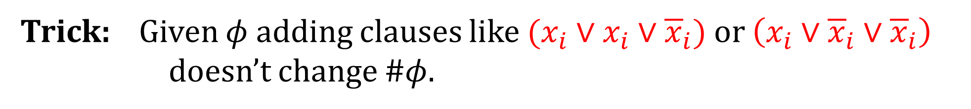

(trivial)
(main)
✔
✔
#3SAT
#3SAT^{bal}
Per_{{−1,0,1}}
Per_{{0,1,…,n}}
Per_{{0,1}}
Every variable in $φ$ appears equally many
times unnegated and negated.
#3SAT^{bal} :
Trick: Given $φ$ adding clauses like $(x_{i}∨x_{i}∨{\overline{x}}_{i})$ or $\left(x_{i}∨{\overline{x}}_{i}∨{\overline{x}}_{i}\right)$
doesn’t change #$φ$.

Slide 24
✔
(main)
✔
✔
#3SAT
#3SAT^{bal}
Per_{{−1,0,1}}
Per_{{0,1,…,n}}
Per_{{0,1}}
Every variable in $φ$ appears equally many
times unnegated and negated.
#3SAT^{bal} :
Trick: Given $φ$ adding clauses like $(x_{i}∨x_{i}∨{\overline{x}}_{i})$ or $\left(x_{i}∨{\overline{x}}_{i}∨{\overline{x}}_{i}\right)$
doesn’t change #$φ$.

Slide 25
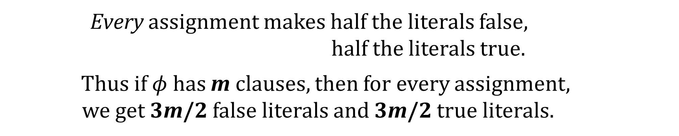
✔
(main)
✔
✔
#3SAT
#3SAT^{bal}
Per_{{−1,0,1}}
Per_{{0,1,…,n}}
Per_{{0,1}}
Every variable in $φ$ appears equally many
times unnegated and negated.
#3SAT^{bal} :
Now : Every assignment makes half the literals false,
half the literals true.
Thus if $φ$ has m clauses, then for every assignment,
we get 3m/2 false literals and 3m/2 true literals.
#3SAT^{bal} →

Slide 26


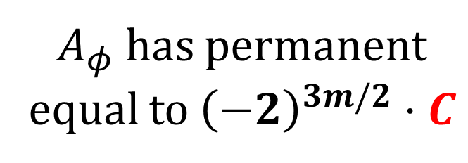
(main reduction)
#3SAT^{bal}
Per_{{−1,0,1}}
$φ$ has m clauses,
C satisfying
assignments
$A_{φ}$has permanent
equal to ${\left(−2\right)}^{3m/2}⋅C$
Thus if $φ$ has m clauses, then for every assignment,
we get 3m/2 false literals and 3m/2 true literals.
#3SAT^{bal} →

Slide 27
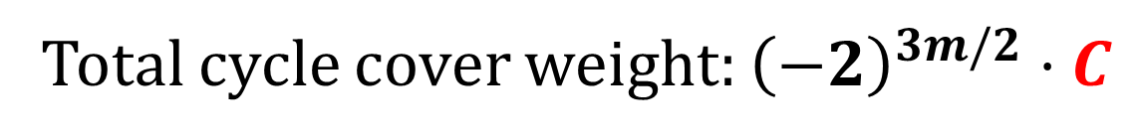
(main reduction)
#3SAT^{bal}
{−1,0,1}-weighted digraph
$φ$ has m clauses,
C satisfying
assignments
Total cycle cover weight: ${\left(−2\right)}^{3m/2}⋅C$
Thus if $φ$ has m clauses, then for every assignment,
we get 3m/2 false literals and 3m/2 true literals.
#3SAT^{bal} →

Slide 28
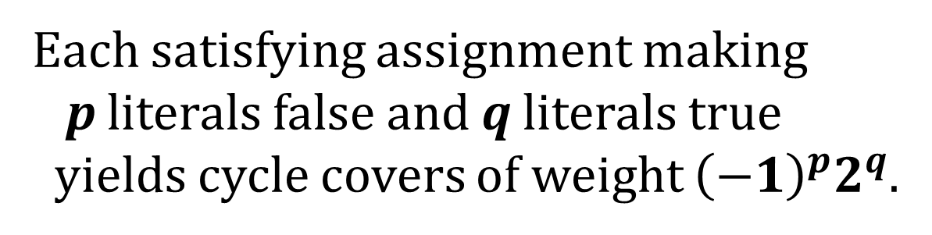
(main reduction)
#3SAT^{bal}
{−1,0,1}-weighted digraph
$φ$ has m clauses,
C satisfying
assignments
Total cycle cover weight: ${\left(−2\right)}^{3m/2}⋅C$
Each satisfying assignment making
p literals false and q literals true
yields cycle covers of weight ${\left(−1\right)}^{p}2^{q}$.
Thus if $φ$ has m clauses, then for every assignment,
we get 3m/2 false literals and 3m/2 true literals.
There are many more cycle covers,
but their total weight is zero!
#3SAT^{bal} →

Slide 29
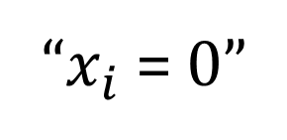
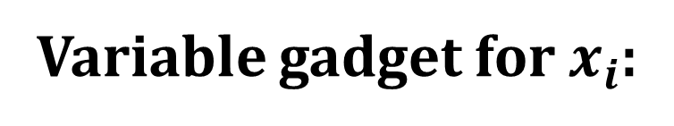
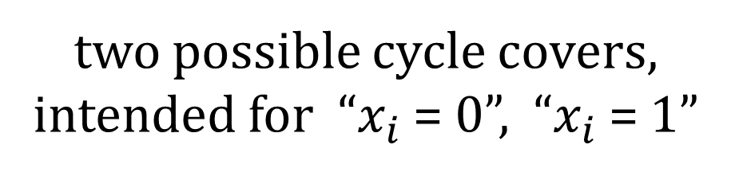
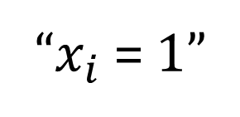
Main Reduction
#3SAT^{bal}
{−1,0,1}-weighted digraph
“$x_{i}$ = 0”
Variable gadget for $x_{i}$:
“$x_{i}$ = 1”
two possible cycle covers,
intended for “$x_{i}$ = 0”, “$x_{i}$ = 1”

Slide 30
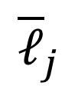

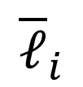
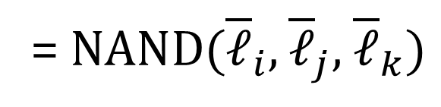
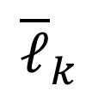
Main Reduction
#3SAT^{bal}
{−1,0,1}-weighted digraph
“$x_{i}$ = 0”
Variable gadget for $x_{i}$:
“$x_{i}$ = 1”
Clause gadget for
$(ℓ_{i}∨ℓ_{j}∨ℓ_{k})$:
$${\overline{ℓ}}_{i}$$
$${\overline{ℓ}}_{j}$$
= NAND$({\overline{ℓ}}_{i},$ ${\overline{ℓ}}_{j},$ ${\overline{ℓ}}_{k})$
$${\overline{ℓ}}_{k}$$

Slide 31
Main Reduction
#3SAT^{bal}
{−1,0,1}-weighted digraph
“$x_{i}$ = 0”
For the three “outside” edges:
If you take all three, you can’t get a cycle cover.
If you take any subset, you can get 1 cycle cover.
“$x_{i}$ = 1”
Clause gadget for
$(ℓ_{i}∨ℓ_{j}∨ℓ_{k})$:
$${\overline{ℓ}}_{i}$$
$${\overline{ℓ}}_{j}$$
= NAND$({\overline{ℓ}}_{i},$ ${\overline{ℓ}}_{j},$ ${\overline{ℓ}}_{k})$
$${\overline{ℓ}}_{k}$$

Slide 32
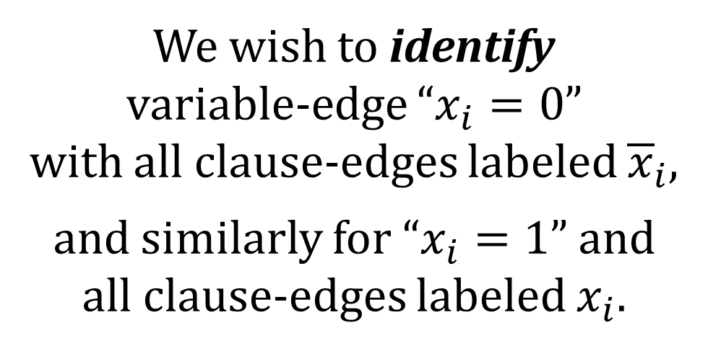
Main Reduction
#3SAT^{bal}
{−1,0,1}-weighted digraph
“$x_{i}$ = 0”
We now “just” need
to enforce consistency.
“$x_{i}$ = 1”
We wish to identify
variable-edge “$x_{i}=0$”
with all clause-edges labeled ${\overline{x}}_{i}$,
and similarly for “$x_{i}=1$” and
all clause-edges labeled $x_{i}$.
$${\overline{ℓ}}_{i}$$
$${\overline{ℓ}}_{j}$$
$${\overline{ℓ}}_{k}$$

Slide 33
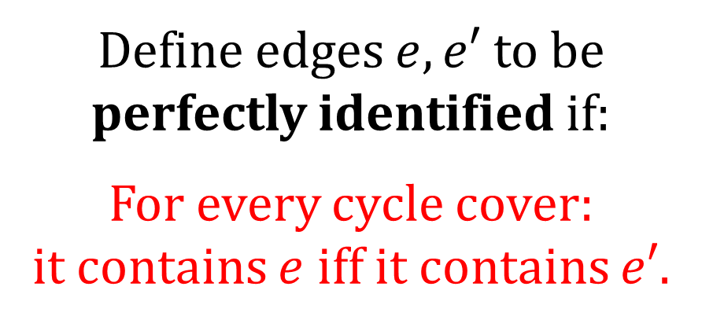
Main Reduction
#3SAT^{bal}
{−1,0,1}-weighted digraph
Define edges $e, e′$ to be
perfectly identified if:
For every cycle cover:
it contains $e$ iff it contains $e′$.
We now “just” need
to enforce consistency.
We wish to identify
variable-edge “$x_{i}=0$”
with all clause-edges labeled ${\overline{x}}_{i}$,
and similarly for “$x_{i}=1$” and
all clause-edges labeled $x_{i}$.
If we could perfectly identify
pairs of edges, we’d be done:
# satisfying assignments
= total weight of cycle covers.

Slide 34
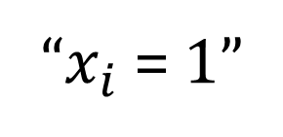
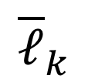
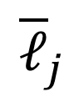
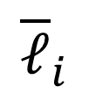
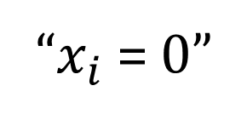
Main Reduction
#3SAT^{bal}
{−1,0,1}-weighted digraph
“$x_{i}$ = 0”
Define edges $e, e′$ to be
perfectly identified if:
For every cycle cover:
it contains $e$ iff it contains $e′$.
“$x_{i}$ = 1”
$${\overline{ℓ}}_{i}$$
$${\overline{ℓ}}_{j}$$
If we could perfectly identify
pairs of edges, we’d be done:
# satisfying assignments
= total weight of cycle covers.
$${\overline{ℓ}}_{k}$$

Slide 35
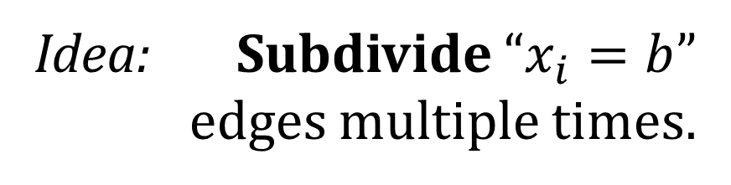
Main Reduction
#3SAT^{bal}
{−1,0,1}-weighted digraph
“$x_{i}$ = 0”
Wrinkle: Each variable appears
in multiple clauses.
“$x_{i}$ = 1”
Idea: Subdivide “$x_{i}=b$”
edges multiple times.
$${\overline{ℓ}}_{i}$$
$${\overline{ℓ}}_{j}$$
$${\overline{ℓ}}_{k}$$

Slide 36
Tricks with Cycle Covers
1
Trick 2: Can always subdivide any edge,
sticking in a self-loop.
4
Claim: Total cycle cover weight unchanged.
2
3
5

Slide 37
Main Reduction
#3SAT^{bal}
{−1,0,1}-weighted digraph
“$x_{i}$ = 0”
Wrinkle: Each variable appears
in multiple clauses.
“$x_{i}$ = 1”
Idea: Subdivide “$x_{i}=b$”
edges multiple times.
$${\overline{ℓ}}_{i}$$
$${\overline{ℓ}}_{j}$$
$${\overline{ℓ}}_{k}$$

Slide 38
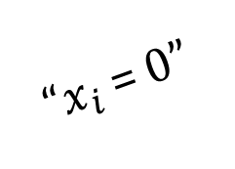
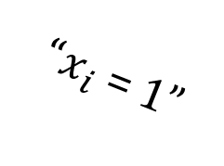
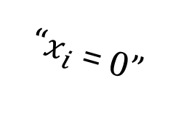
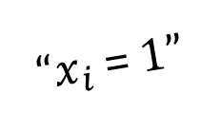
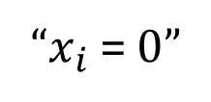
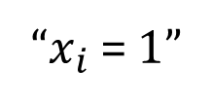
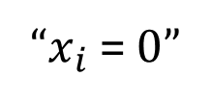
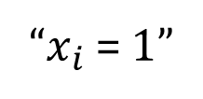
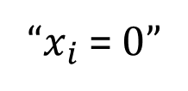
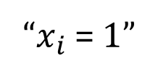
Main Reduction
#3SAT^{bal}
{−1,0,1}-weighted digraph
“$x_{i}$ = 0”
Wrinkle: Each variable appears
in multiple clauses.
“$x_{i}$ = 1”
Idea: Subdivide “$x_{i}=b$”
edges multiple times.
“$x_{i}$ = 0”
“$x_{i}$ = 0”
“$x_{i}$ = 0”
“$x_{i}$ = 0”
“$x_{i}$ = 0”
“$x_{i}$ = 1”
“$x_{i}$ = 1”
“$x_{i}$ = 1”
“$x_{i}$ = 1”
“$x_{i}$ = 1”

Slide 39

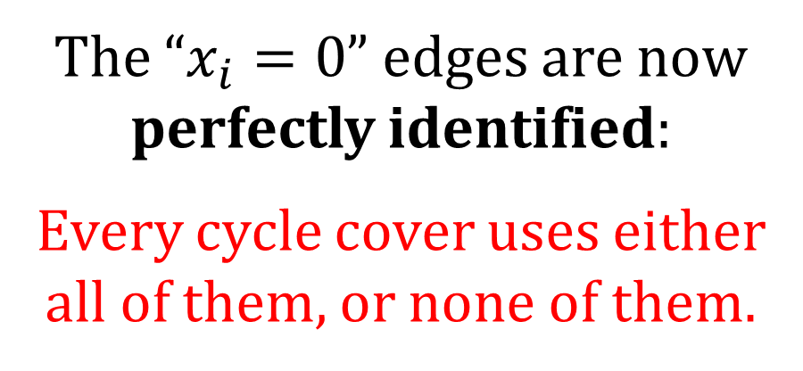
Main Reduction
#3SAT^{bal}
{−1,0,1}-weighted digraph
The “$x_{i}=0$” edges are now
perfectly identified:
Every cycle cover uses either
all of them, or none of them.
Similarly for the “$x_{i}=1$” edges.
“$x_{i}$ = 0”
“$x_{i}$ = 0”
“$x_{i}$ = 0”
“$x_{i}$ = 0”
“$x_{i}$ = 0”
“$x_{i}$ = 1”
“$x_{i}$ = 1”
“$x_{i}$ = 1”
“$x_{i}$ = 1”
“$x_{i}$ = 1”

Slide 40



Main Reduction
#3SAT^{bal}
{−1,0,1}-weighted digraph
$${\overline{ℓ}}_{i}$$
$${\overline{ℓ}}_{j}$$
Wrinkle fixed:
For each variable/clause occurrence,
we can try to identify a pair of edges.
$${\overline{ℓ}}_{k}$$
“$x_{i}$ = 0”
“$x_{i}$ = 0”
“$x_{i}$ = 0”
“$x_{i}$ = 0”
“$x_{i}$ = 0”
“$x_{i}$ = 1”
“$x_{i}$ = 1”
“$x_{i}$ = 1”
“$x_{i}$ = 1”
“$x_{i}$ = 1”

Slide 41




Last Step: Trying to identify a pair of edges
We will not be able to
perfectly identify them. ☹
$$u$$
$$v$$
But we’ll see a gadget
that does something
that’s good enough. ☺
$$u′$$
$$v′$$

Slide 42




Last Step: Trying to identify a pair of edges
$$u$$
$$v$$
$$u$$
gadget
$$v$$
$$u′$$
$$v′$$
$$u′$$
$$v′$$
Old graph
New graph

Slide 43
(a) To every “old” cycle cover of weight W using both edges,
there corresponds a “new” cycle cover of weight −W.
(b) To every “old” cycle cover of weight W using neither edge,
there correspond several “new” cycle covers of weight 2W.
(c) All remaining other “new” cycle covers have total weight zero.
Identification
gadget properties:
$$u$$
$$v$$
$$u$$
gadget
$$v$$
$$u′$$
$$v′$$
$$u′$$
$$v′$$
Old graph
New graph

Slide 44
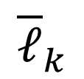
Main Reduction
#3SAT^{bal}
{−1,0,1}-weighted digraph
“$x_{i}$ = 0”
We now “just” need
to enforce consistency.
“$x_{i}$ = 1”
We wish to identify
variable-edge “$x_{i}=0$”
with all clause-edges labeled ${\overline{x}}_{i}$,
and similarly for “$x_{i}=1$” and
all clause-edges labeled $x_{i}$.
$${\overline{ℓ}}_{i}$$
$${\overline{ℓ}}_{j}$$
$${\overline{ℓ}}_{k}$$

Slide 45
Main Reduction
#3SAT^{bal}
{−1,0,1}-weighted digraph
“$x_{i}$ = 0”
Define edges $e, e′$ to be
perfectly identified if:
For every cycle cover:
it contains $e$ iff it contains $e′$.
“$x_{i}$ = 1”
$${\overline{ℓ}}_{i}$$
$${\overline{ℓ}}_{j}$$
If we could perfectly identify
pairs of edges, we’d be done:
# satisfying assignments
= total weight of cycle covers.
$${\overline{ℓ}}_{k}$$

Slide 46
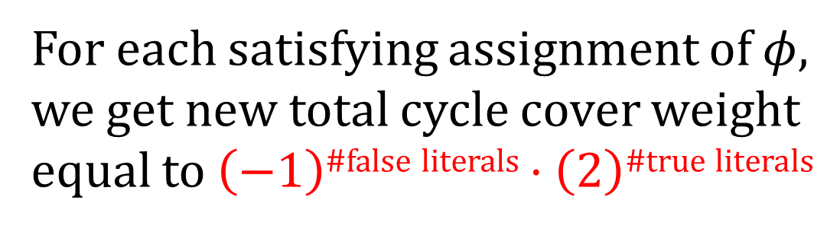
Main Reduction
#3SAT^{bal}
{−1,0,1}-weighted digraph
“$x_{i}$ = 0”
Using Identification gadget instead…
(a) To every “old” cycle cover of weight W using both edges,
there corresponds a “new” cycle cover of weight −W.
(b) To every “old” cycle cover of weight W using neither edge,
there correspond several “new” cycle covers of weight 2W.
(c) All remaining other “new” cycle covers have total weight zero.
“$x_{i}$ = 1”
$${\overline{ℓ}}_{i}$$
$${\overline{ℓ}}_{j}$$
For each satisfying assignment of $φ$,
we get new total cycle cover weight
equal to $\left(−1\right)$^{#false literals} $⋅\left(2\right)\text{\#}\text{true} \text{literals}$
$${\overline{ℓ}}_{k}$$

Slide 47


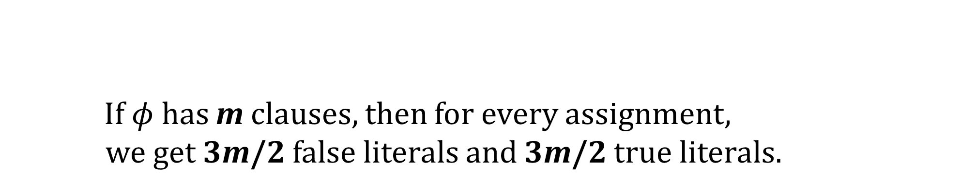
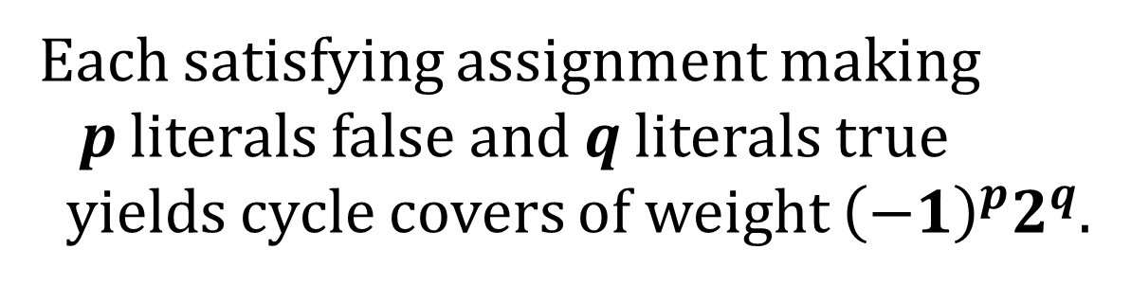
Thus the Identification gadget completes the reduction!
#3SAT^{bal}
{−1,0,1}-weighted digraph
$φ$ has m clauses,
C satisfying
assignments
Total cycle cover weight: ${\left(−2\right)}^{3m/2}⋅C$
Each satisfying assignment making
p literals false and q literals true
yields cycle covers of weight ${\left(−1\right)}^{p}2^{q}$.
If $φ$ has m clauses, then for every assignment,
we get 3m/2 false literals and 3m/2 true literals.
#3SAT^{bal} →

Slide 48








(a) To every “old” cycle cover of weight W using both edges,
there corresponds a “new” cycle cover of weight −W.
(b) To every “old” cycle cover of weight W using neither edge,
there correspond several “new” cycle covers of weight 2W.
(c) All remaining other “new” cycle covers have total weight zero.
Identification
gadget properties:
$$u$$
$$v$$
$$u$$
gadget
$$v$$
$$u′$$
$$v′$$
$$u′$$
$$v′$$
Old graph
New graph

Slide 49
Identification gadget revealed
$$u$$
$$v$$
$$u$$
gadget
$$v$$
$$u′$$
$$v′$$
$$u′$$
$$v′$$
Old graph
New graph

Slide 50
Identification gadget revealed
$$u$$
$$v$$
$$u$$
$$v$$
−1
$$u′$$
$$v′$$
$$u′$$
$$v′$$
Old graph
New graph

Slide 51
We must study all possible cycle covers in the new graph.
$$u$$
$$v$$
$$u$$
$$v$$
−1
$$u′$$
$$v′$$
$$u′$$
$$v′$$
Old graph
New graph

Slide 52
We must study all possible cycle covers in the new graph.
Divide into cases based on which of the wobbling edges are taken.
$$u$$
$$v$$
$$u$$
$$v$$
−1
$$u′$$
$$v′$$
$$u′$$
$$v′$$
Old graph
New graph

Slide 53
One case: Both top edges, neither bottom edge
What must the rest of the cycle cover in the new graph look like?
$$u$$
$$v$$
$$u$$
$$v$$
−1
$$u′$$
$$v′$$
$$u′$$
$$v′$$
Old graph
New graph

Slide 54
One case: Both top edges, neither bottom edge
What must the rest of the cycle cover in the new graph look like?
$$u$$
$$v$$
$$u$$
$$v$$
some “inconsistent”
cycle cover, of weight W
−1
$$u′$$
$$v′$$
$$u′$$
$$v′$$
Old graph
New graph

Slide 55
One case: Both top edges, neither bottom edge
What must the rest of the cycle cover in the new graph look like?
$$u$$
$$v$$
$$u$$
$$v$$
some “inconsistent”
cycle cover, of weight W
Not finished here!
−1
$$u′$$
$$v′$$
$$u′$$
$$v′$$
Old graph
New graph

Slide 56
One case: Both top edges, neither bottom edge
What must the rest of the cycle cover in the new graph look like?
$$u$$
$$v$$
$$u$$
$$v$$
some “inconsistent”
cycle cover, of weight W
a cover of
weight −W
−1
$$u′$$
$$v′$$
$$u′$$
$$v′$$
Old graph
New graph

Slide 57
One case: Both top edges, neither bottom edge
What must the rest of the cycle cover in the new graph look like?
$$u$$
$$v$$
$$u$$
$$v$$
some “inconsistent”
cycle cover, of weight W
a cover of
weight +W
−1
$$u′$$
$$v′$$
$$u′$$
$$v′$$
Old graph
New graph

Slide 58
One case: Both top edges, neither bottom edge
What must the rest of the cycle cover in the new graph look like?
$$u$$
$$v$$
$$u$$
$$v$$
some “inconsistent”
cycle cover, of weight W
The two covers
cancel out!
−1
$$u′$$
$$v′$$
$$u′$$
$$v′$$
Old graph
New graph

Slide 59
One case: Both top edges, neither bottom edge
What must the rest of the cycle cover in the new graph look like?
This phenomenon
will occur for
all the “bad”
cases in the new graph; e.g.,
both bottom edges,
neither top edge.
$$u$$
$$v$$
$$u$$
$$v$$
some “inconsistent”
cycle cover, of weight W
The two covers
cancel out!
−1
$$u′$$
$$v′$$
$$u′$$
$$v′$$
Old graph
New graph

Slide 60
Another bad case: Top left edge, bottom right edge
What must the rest of the cycle cover in the new graph look like?
$$u$$
$$v$$
$$u$$
$$v$$
Doesn’t correspond
to anything over here!
−1
$$u′$$
$$v′$$
$$u′$$
$$v′$$
Old graph
New graph

Slide 61
Another bad case: Top left edge, bottom right edge
What must the rest of the cycle cover in the new graph look like?
$$u$$
$$v$$
$$u$$
$$v$$
Doesn’t correspond
to anything over here!
Say the weight
so far is W
−1
$$u′$$
$$v′$$
$$u′$$
$$v′$$
Old graph
New graph

Slide 62
Another bad case: Top left edge, bottom right edge
What must the rest of the cycle cover in the new graph look like?
$$u$$
$$v$$
$$u$$
$$v$$
Doesn’t correspond
to anything over here!
One finish of
weight −W
−1
$$u′$$
$$v′$$
$$u′$$
$$v′$$
Old graph
New graph

Slide 63
Another bad case: Top left edge, bottom right edge
What must the rest of the cycle cover in the new graph look like?
$$u$$
$$v$$
$$u$$
$$v$$
Doesn’t correspond
to anything over here!
One finish of
weight +W
−1
$$u′$$
$$v′$$
$$u′$$
$$v′$$
Old graph
New graph

Slide 64
Another bad case: Top left edge, bottom right edge
What must the rest of the cycle cover in the new graph look like?
$$u$$
$$v$$
$$u$$
$$v$$
Doesn’t correspond
to anything over here!
Again, these
bad covers
cancel out!
−1
$$u′$$
$$v′$$
$$u′$$
$$v′$$
Old graph
New graph

Slide 65
Yet another bad case: Both top edges, bottom right edge
What must the rest of the cycle cover in the new graph look like?
Actually, it’s impossible!
$$u$$
$$v$$
$$u$$
$$v$$
−1
$$u′$$
$$v′$$
$$u′$$
$$v′$$
Old graph
New graph

Slide 66
All “bad” cases complete; they contribute zero total weight.
This was part (c) of the Identification gadget properties.
What remains: two “good” cases.
$$u$$
$$v$$
$$u$$
$$v$$
−1
$$u′$$
$$v′$$
$$u′$$
$$v′$$
Old graph
New graph

Slide 67
One good case: All four edges taken.
What must the rest of the cycle cover in the new graph look like?
$$u$$
$$v$$
$$u$$
$$v$$
−1
$$u′$$
$$v′$$
$$u′$$
$$v′$$
Old graph
New graph

Slide 68
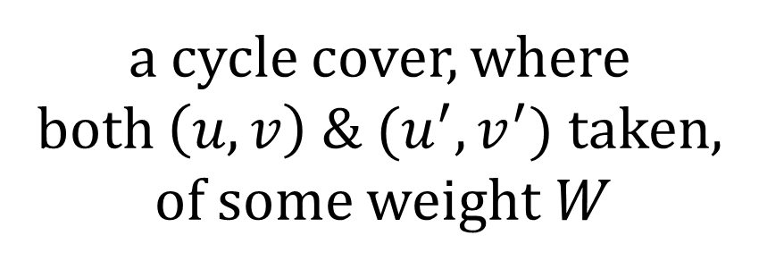
One good case: All four edges taken.
What must the rest of the cycle cover in the new graph look like?
$$u$$
$$v$$
$$u$$
$$v$$
a cycle cover, where
both $\left(u,v\right) \& (u^{′},v^{′})$ taken,
of some weight W
−1
$$u′$$
$$v′$$
$$u′$$
$$v′$$
Old graph
New graph

Slide 69
One good case: All four edges taken.
What must the rest of the cycle cover in the new graph look like?
$$u$$
$$v$$
$$u$$
$$v$$
a cycle cover, where
both $\left(u,v\right) \& (u^{′},v^{′})$ taken,
of some weight W
only finish has
weight −W
−1
$$u′$$
$$v′$$
$$u′$$
$$v′$$
Old graph
New graph

Slide 70
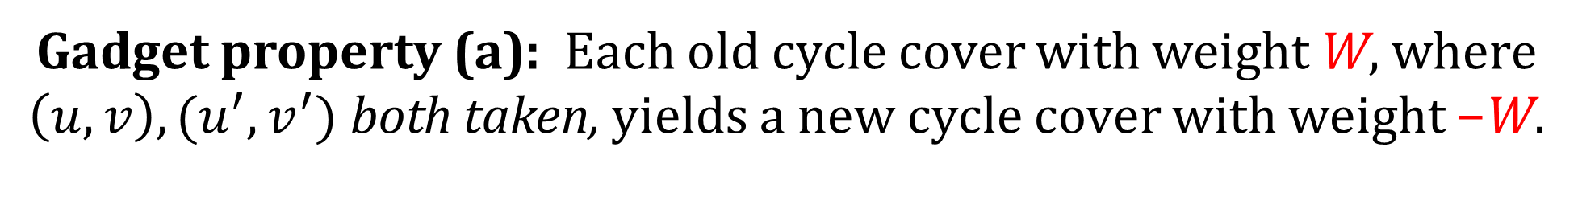
Gadget property (a): Each old cycle cover with weight W, where
$\left(u,v\right), (u^{′},v^{′})$ both taken, yields a new cycle cover with weight −W.
$$u$$
$$v$$
$$u$$
$$v$$
a cycle cover, where
both $\left(u,v\right) \& (u^{′},v^{′})$ taken,
of some weight W
only finish has
weight −W
−1
$$u′$$
$$v′$$
$$u′$$
$$v′$$
Old graph
New graph

Slide 71
Final (good) case: None of the four edges is taken.
What must the rest of the cycle cover in the new graph look like?
$$u$$
$$v$$
$$u$$
$$v$$
−1
$$u′$$
$$v′$$
$$u′$$
$$v′$$
Old graph
New graph

Slide 72
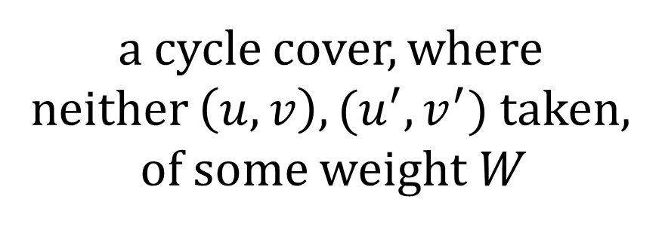
Final (good) case: None of the four edges is taken.
What must the rest of the cycle cover in the new graph look like?
$$u$$
$$v$$
$$u$$
$$v$$
a cycle cover, where
neither $\left(u,v\right), (u^{′},v^{′})$ taken,
of some weight W
Exercise: there are
6 finishes here,
of total weight 2W
−1
$$u′$$
$$v′$$
$$u′$$
$$v′$$
Old graph
New graph

Slide 73
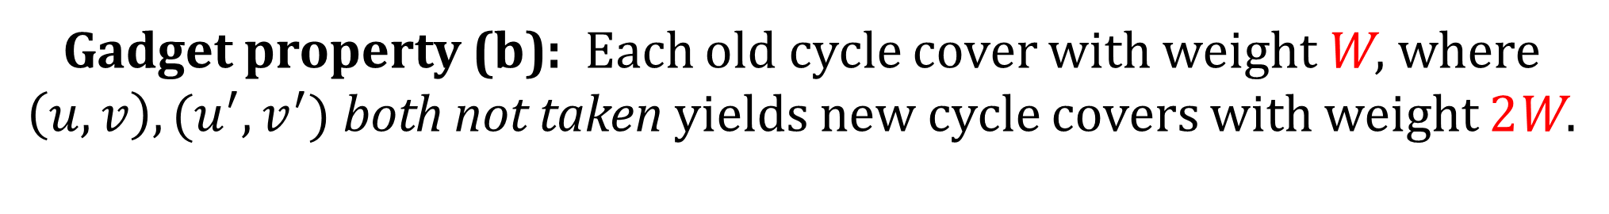
Gadget property (b): Each old cycle cover with weight W, where
$\left(u,v\right), (u^{′},v^{′})$ both not taken yields new cycle covers with weight 2W.
$$u$$
$$v$$
$$u$$
$$v$$
a cycle cover, where
neither $\left(u,v\right), (u^{′},v^{′})$ taken,
of some weight W
Exercise: there are
6 finishes here,
of total weight 2W
−1
$$u′$$
$$v′$$
$$u′$$
$$v′$$
Old graph
New graph

Slide 74
(a) To every “old” cycle cover of weight W using both edges,
there corresponds a “new” cycle cover of weight −W.
(b) To every “old” cycle cover of weight W using neither edge,
there correspond several “new” cycle covers of weight 2W.
(c) All remaining other “new” cycle covers have total weight zero.
Identification
gadget properties:
All gadget properties verified!
The reduction is complete.

